Slide 1


Dealing with Uncertainty

Slide 2

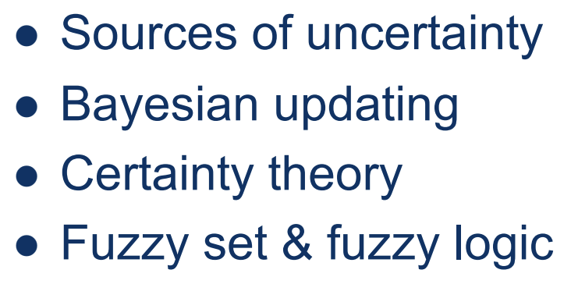
Outline

Slide 3
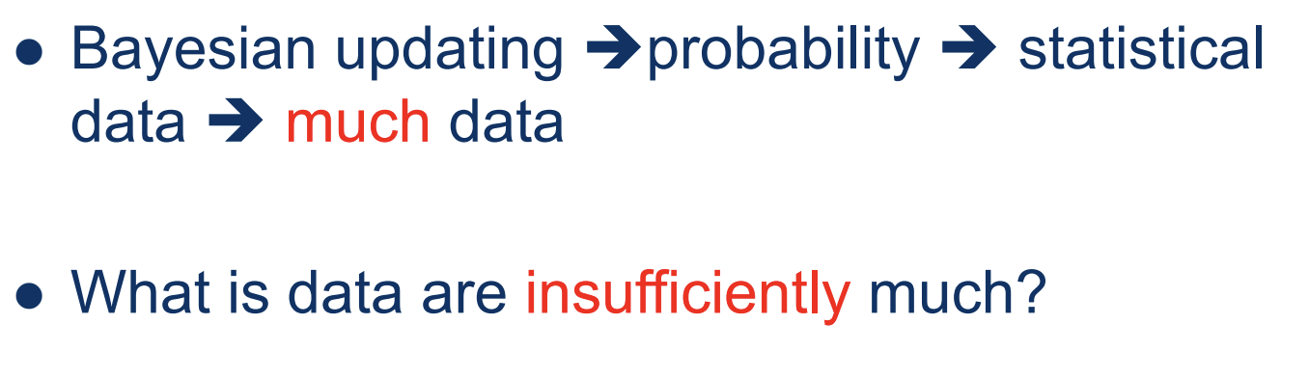
Certainty Theory

Slide 4
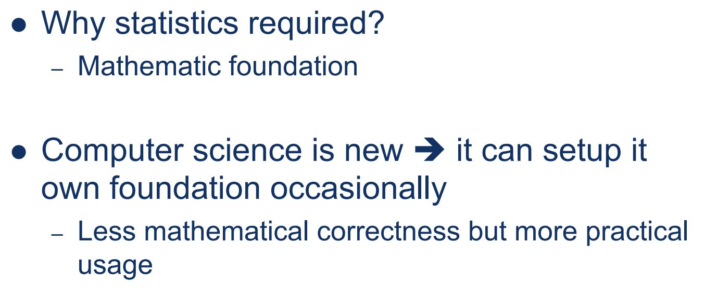
Certainty Theory

Slide 5
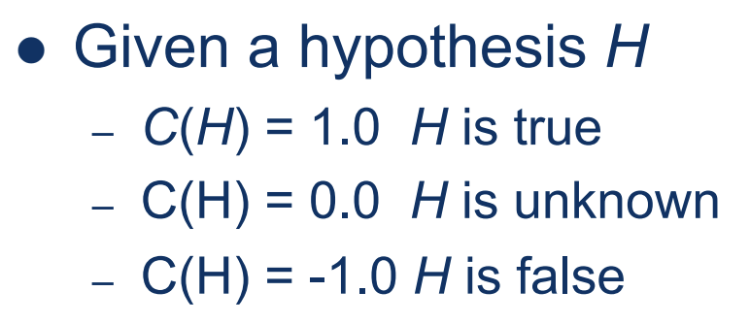

Certainty Value

Slide 6

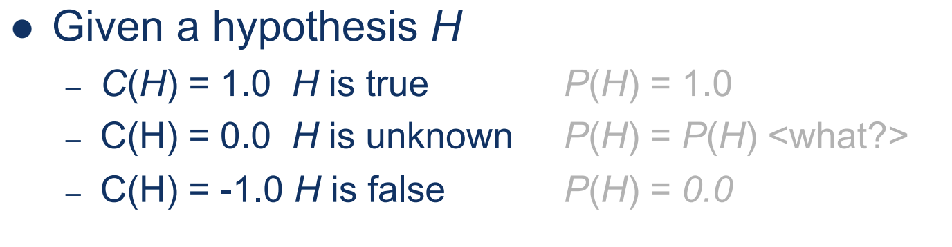
Certainty Value

Slide 7

Certainty Factor

Slide 8

Certainty Factor

Slide 9

Certainty Factor

Slide 10
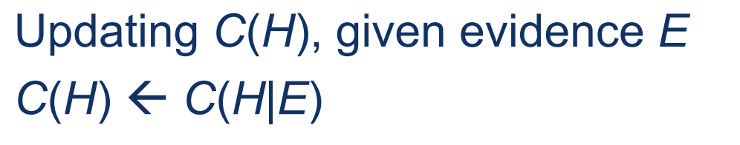
Certainty Updating

Slide 11
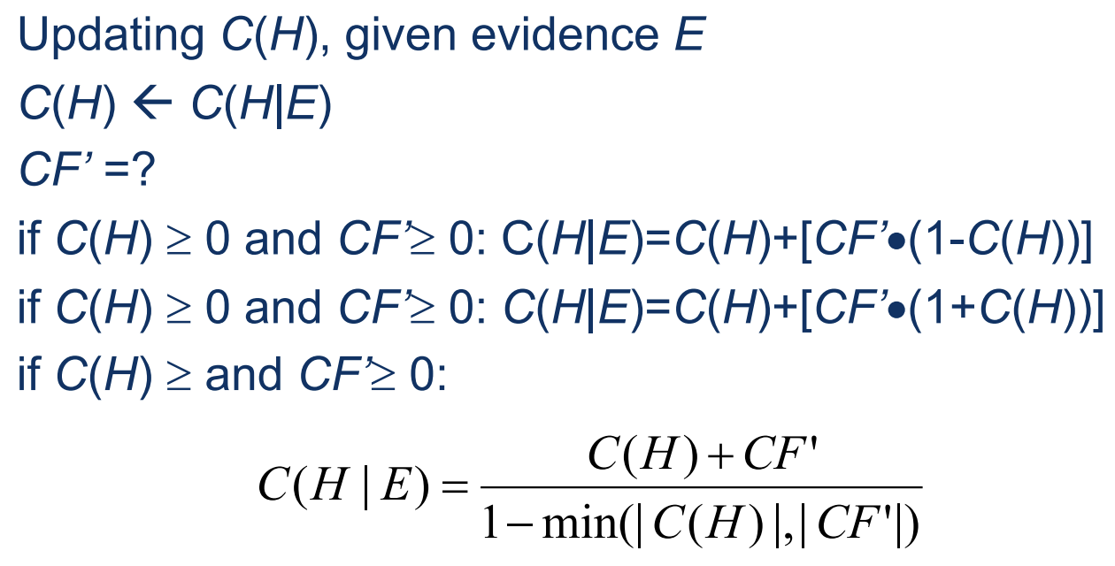
Certainty Updating

Slide 12
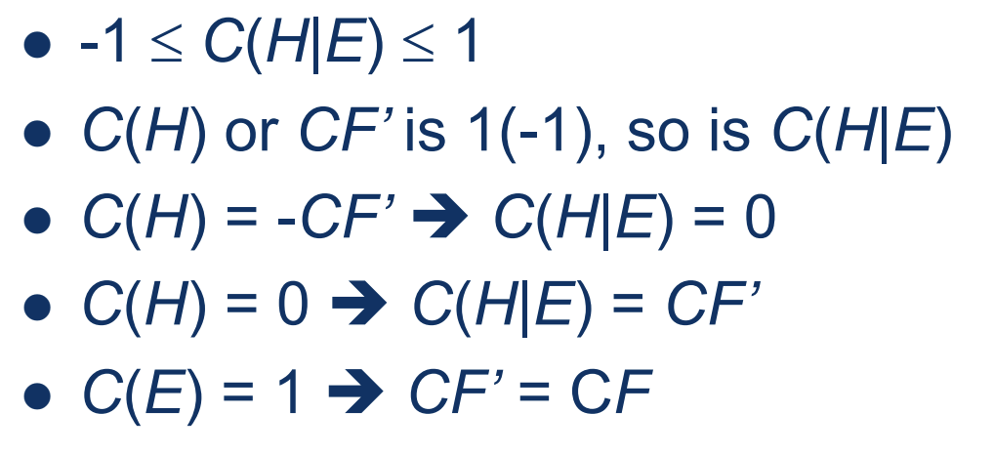
Meanings behind

Slide 13
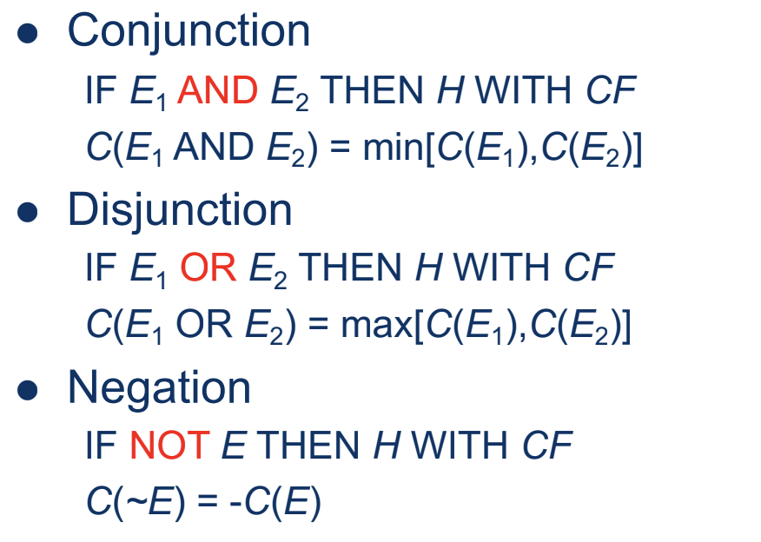
Evidence Logical Combination

Slide 14

Example

Slide 15
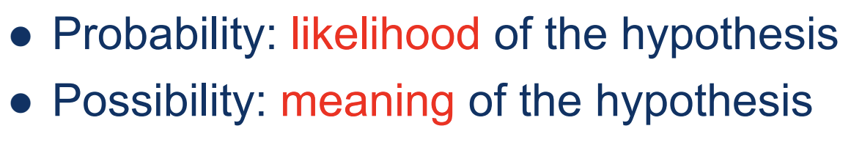
Possibility theory

Slide 16

Possibility theory

Slide 17

Possibility theory

Slide 18
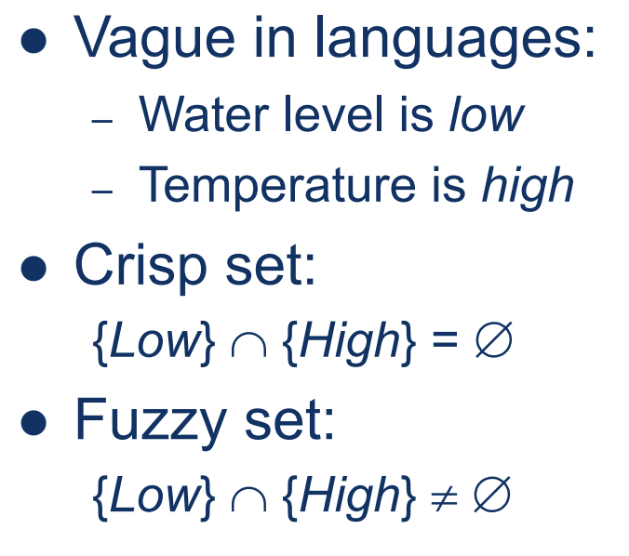
Crisp set and fuzzy set

Slide 19
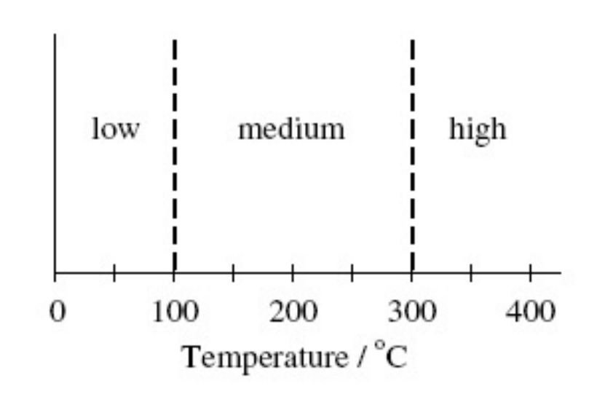
Crisp set

Slide 20
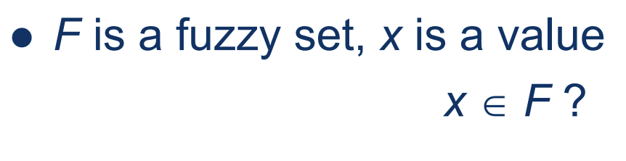
Fuzzy set

Slide 21
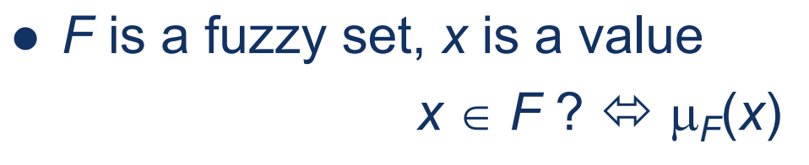
Fuzzy set

Slide 22
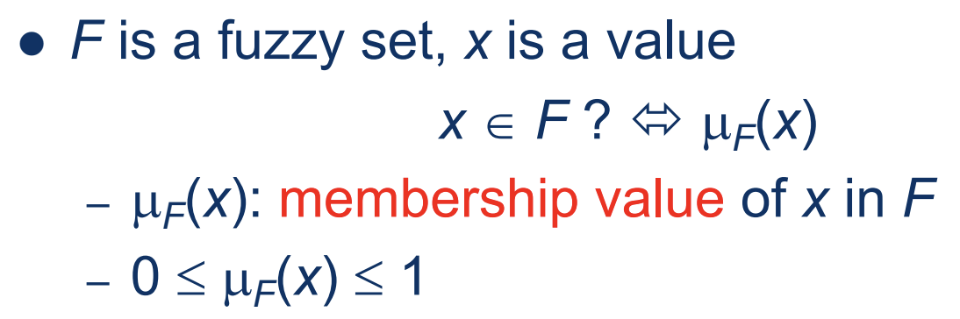
Fuzzy set

Slide 23
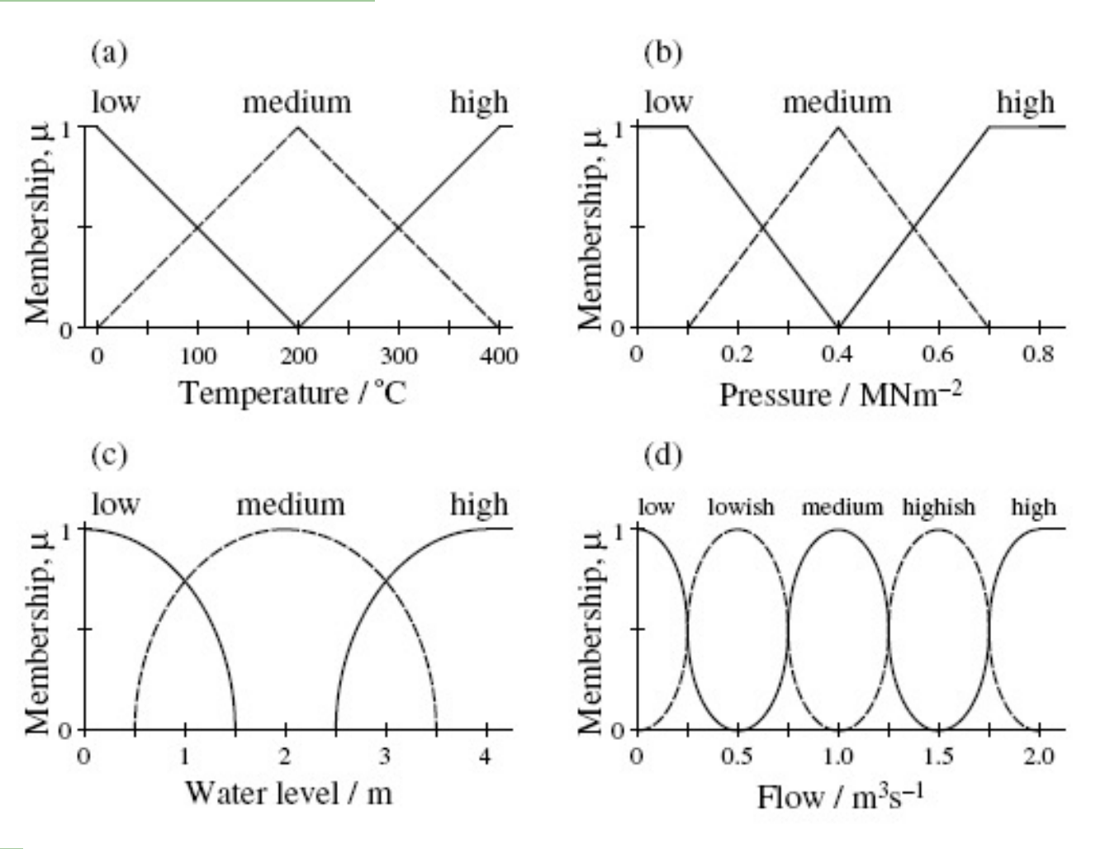

Slide 24
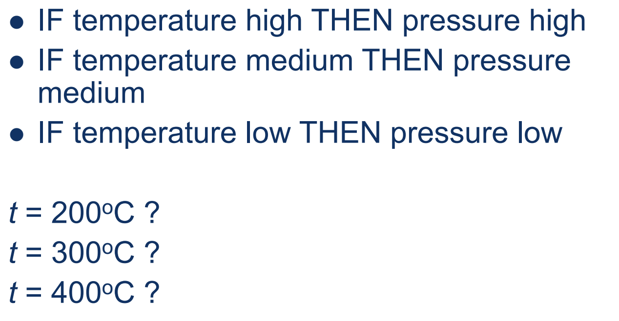
Fuzzy rules

Slide 25
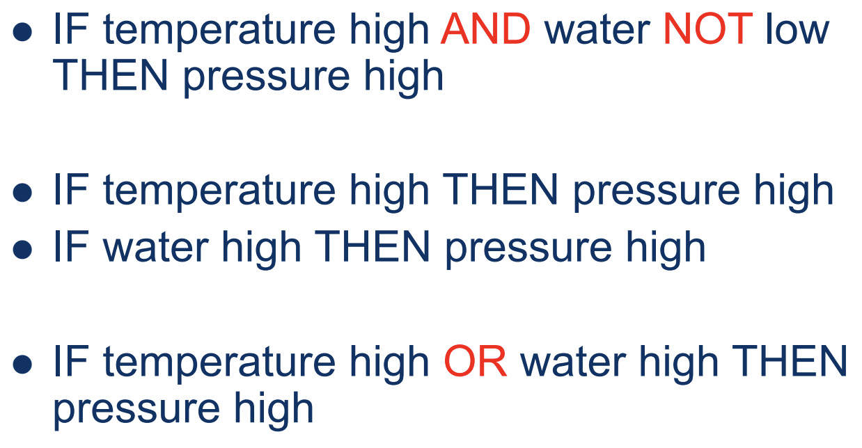
Condition Combination

Slide 26
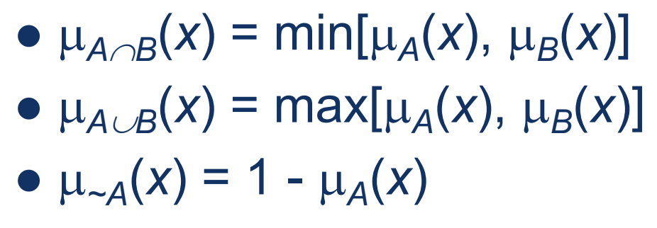
Fuzzy Logic

Slide 27
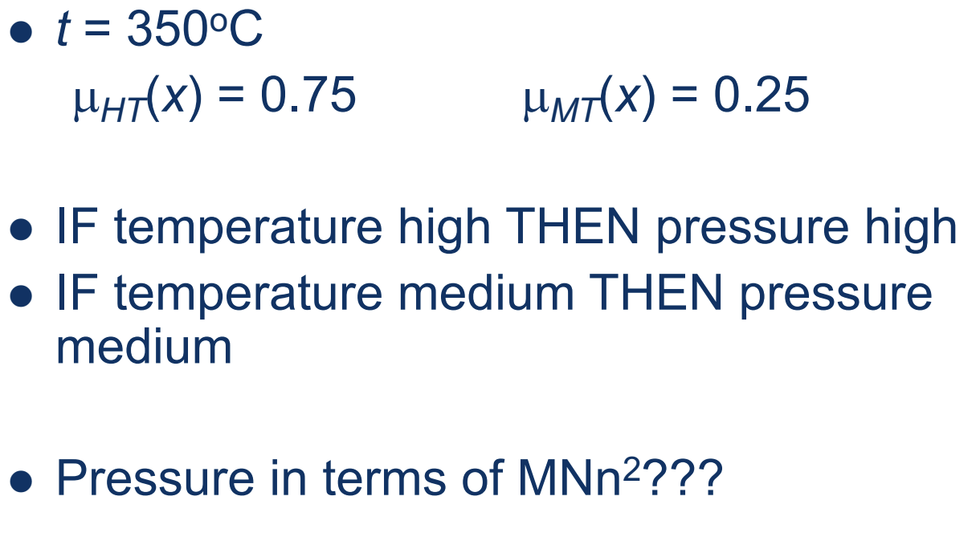
Defuzzification

Slide 28
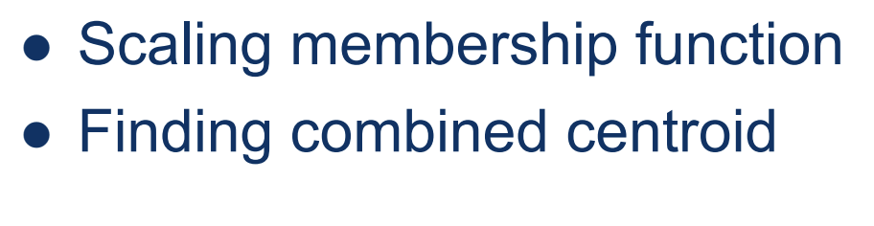
Defuzzification

Slide 29

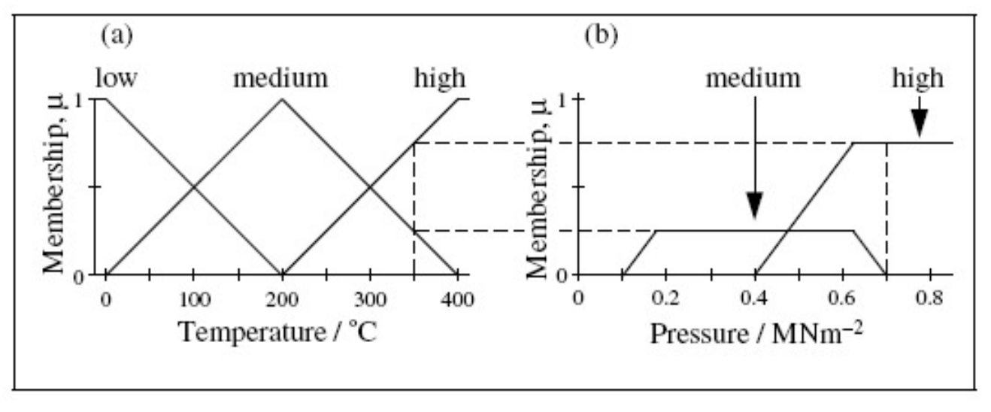
Scaling membership function –
Mamdami’s method

Slide 30
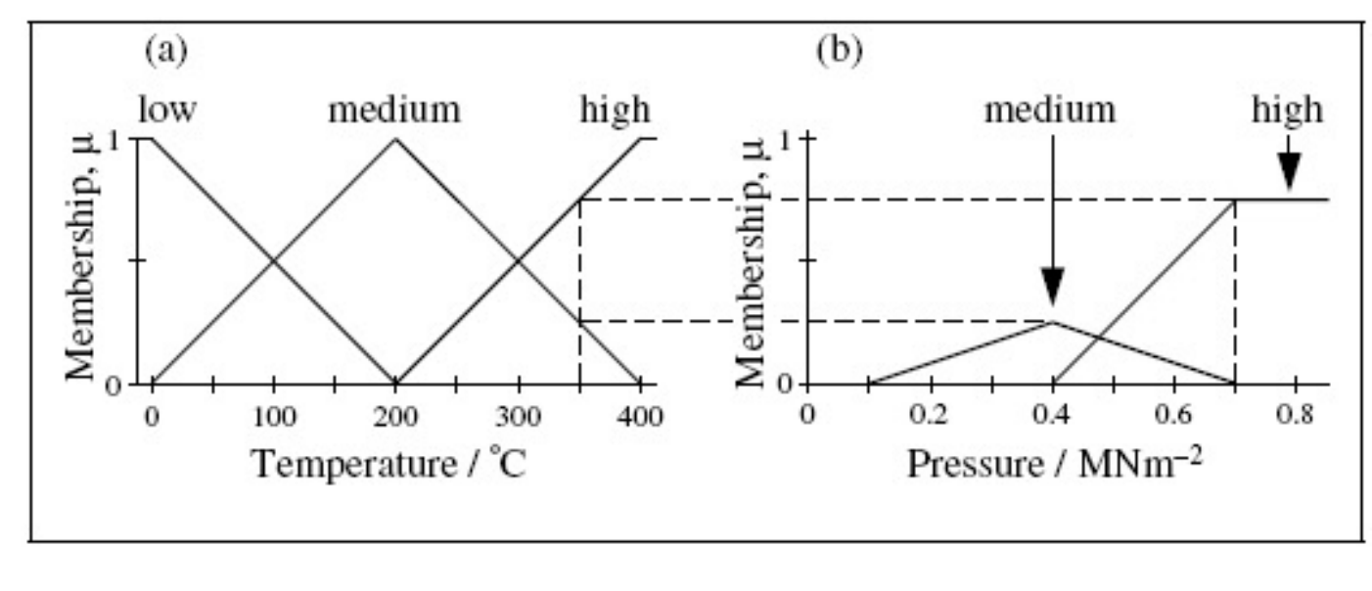
Scaling membership function –
Larson’s method

Slide 31

Finding combined centroid

Slide 32
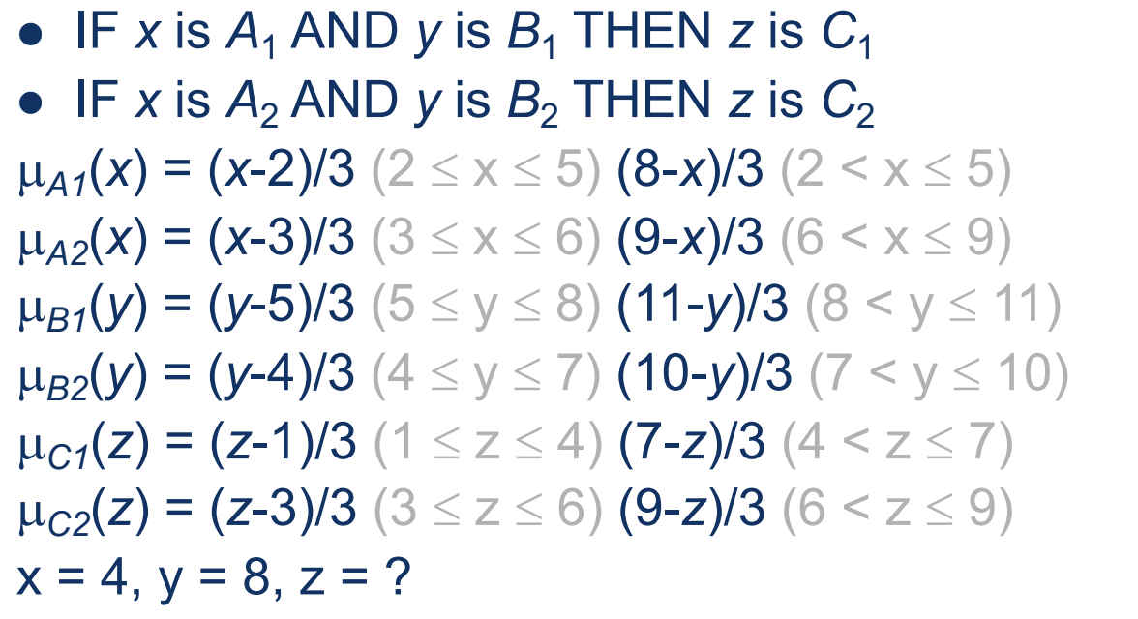
Worked Example

Slide 33
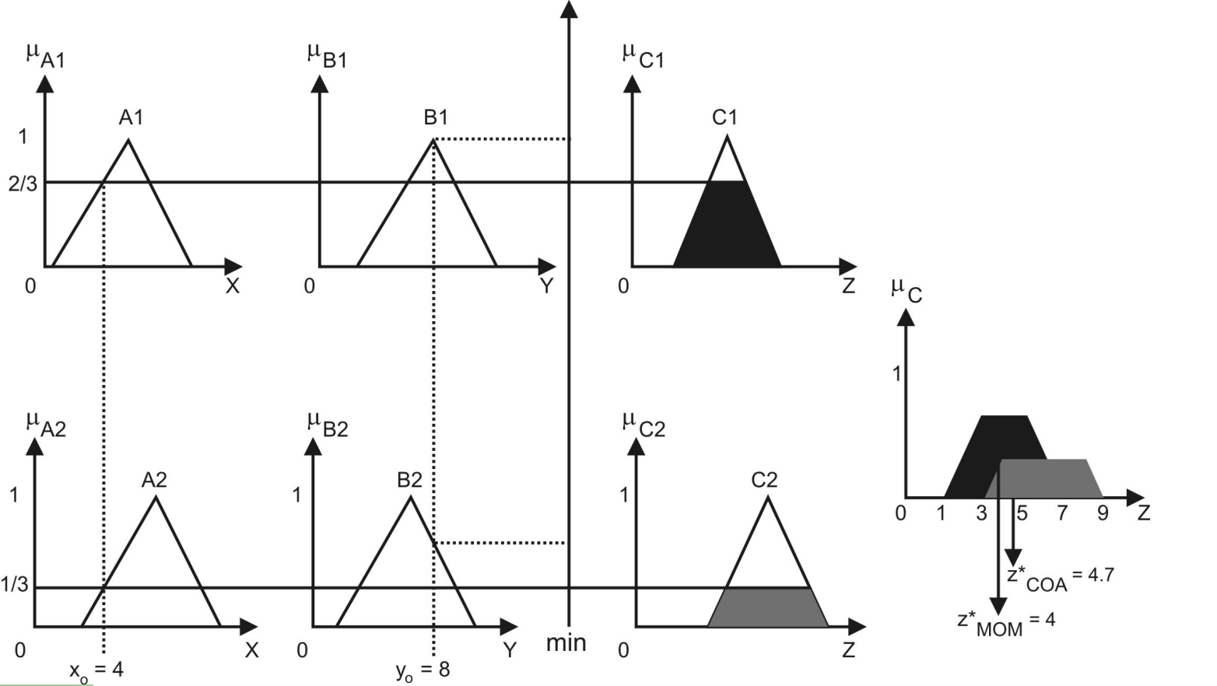

Slide 34
Thank you for
your attention

